Slide 1


ArcGIS, Python, R…Where do they all fit together?
Tom Yamashita
24 October 2019
Introduction to Scientific Computing
Notes:
If you’re reading the notes, sorry about any spelling, grammar, or formatting errors. They’re just notes

Slide 2
Goals part 1
How is R different from Python?
What are they good for?
Can you use both?
Let’s play a little bit

Slide 3

Using R vs. Python
Both are great
But they are better at performing different tasks
Notes:
NOTE: I use package and library interchangeably as R and Python use the different terminology to mean the same thing

Slide 4
R usage
Statistics
Especially regression and ANOVA
But also most other stats that exist
Data management
Especially for excel files and other data in tabular formats
Making figures*
GGPlot2
Documentation for packages tends to be quite comprehensive
CRAN requires all libraries to have full documentation for all functions

Slide 5
Python usage
Data management
Especially for NetCDF files and spatial data
Analysis of NetCDF files and other giant datasets
Making programs
Robotics
Machine learning
Making figures
Matplotlib
Sometimes library updates are faster that documentation updates
No checking of documentation for python packages

Slide 6


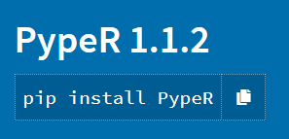
Using both programs
R package for running python
reticulate
Python libraries for running R
PypeR
rpy2
https://rpy2.bitbucket.io/
https://pypi.org/project/PypeR/
https://rstudio.github.io/reticulate/
Notes:
I haven’t used any of these but supposedly if you want to do Python in R, you can use the reticulate package
And if you want to do R in Python, you can use either PypeR or rpy2

Slide 7
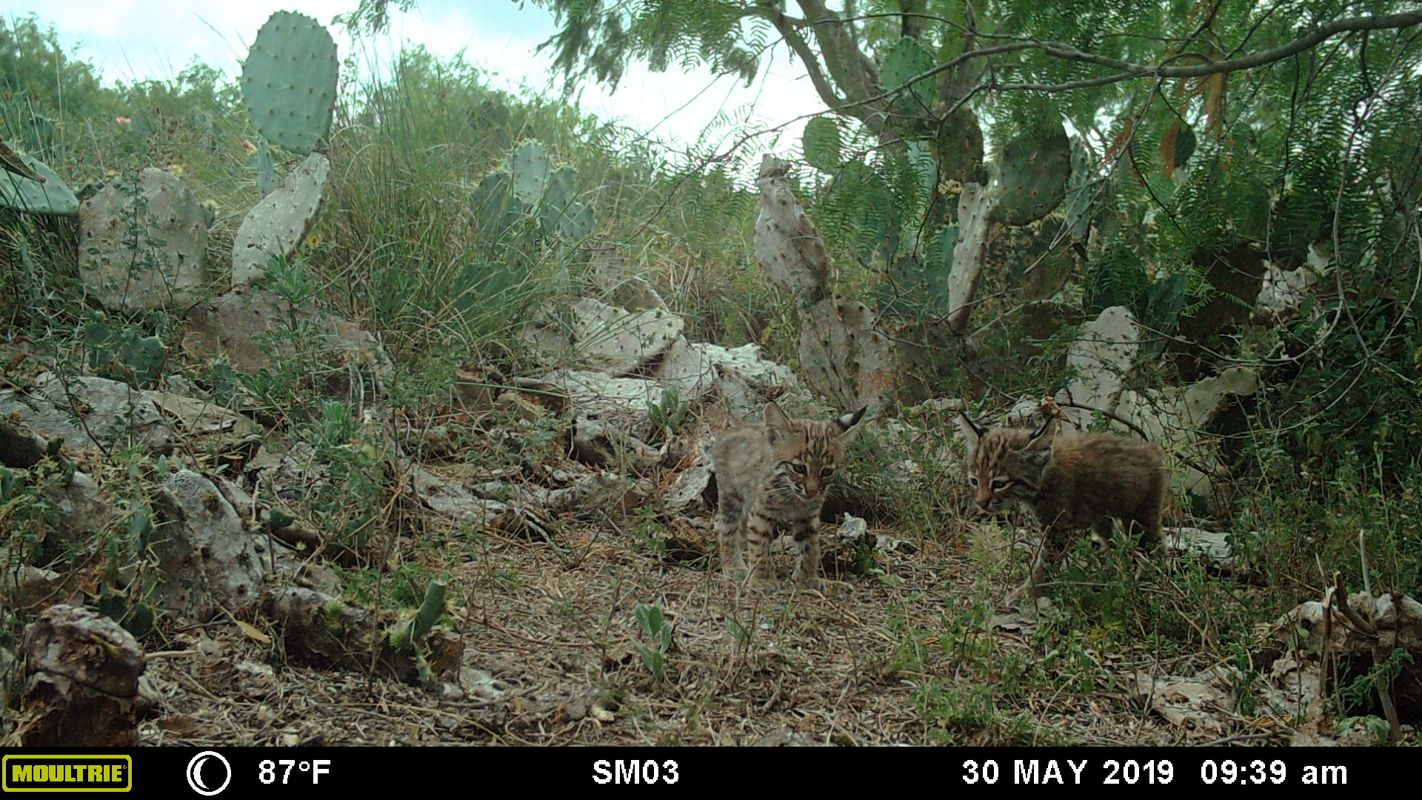
Let’s open R and do stuff

Slide 8
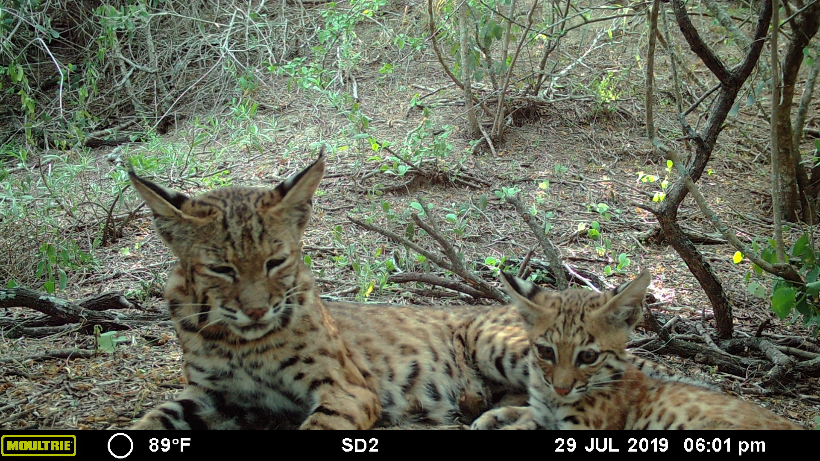
Break Time?
Photo credit: Kline Lab at UTRGV

Slide 9
Goals Part 2
What is GIS and what can you do with it?
Introduction to ArcGIS
Where does Python fit in?
Python 2 vs. Python 3
Compatibility between ArcGIS and Anaconda
Using R or Python or both at the same time?
Notes:
We’re going to go through these things…
Question first: Who is familiar with what GIS is? Who has used a GIS before? What have you done with one?

Slide 10
What is GIS?
“A geographic information system (GIS) is a framework for gathering, managing, and analyzing data. Rooted in the science of geography, GIS integrates many types of data. It analyzes spatial location and organizes layers of information into visualizations using maps and 3D scenes. ​With this unique capability, GIS reveals deeper insights into data, such as patterns, relationships, and situations—helping users make smarter decisions.”
-ESRI
A map making tool but also a lot more
https://www.esri.com/en-us/what-is-gis/overview
Notes:
Not a program. It’s a framework for handling and analyzing spatial data
ESRI has a longer definition with an emphasis on the usefulness of a GIS for management but in its essence, for scientists it is a useful tool to presenting spatial data in meaningful and effective ways
The key is the spatial data part. Geography is at the core of GIS

Slide 11


GIS Programs
Proprietary option
ArcGIS
Free options
QGIS
Others
Programming options
Python
R
https://gisgeography.com/free-gis-software/
Notes:
Many different programs for doing GIS
Proprietary options such as ArcGIS
Free options such as QGIS and others
Programming options such as Python and R
Several free/open source alternatives to ArcGIS
QGIS is the main one. I’ve never used it but from what I’ve heard it’s decent and functional
There are also these others that I had never heard of until I looked it up for this lecture
Additionally, we can do GIS using Python and R
These tend to not have the specialized functions that a dedicated GIS has so you tend to have to make your own

Slide 12
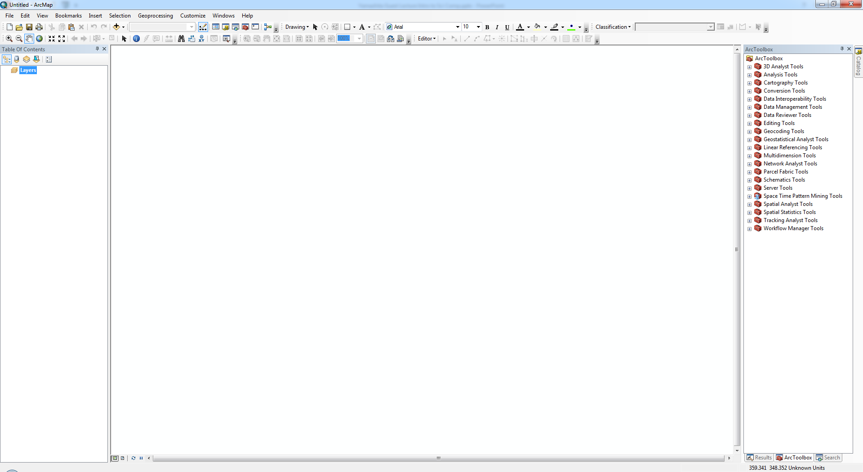
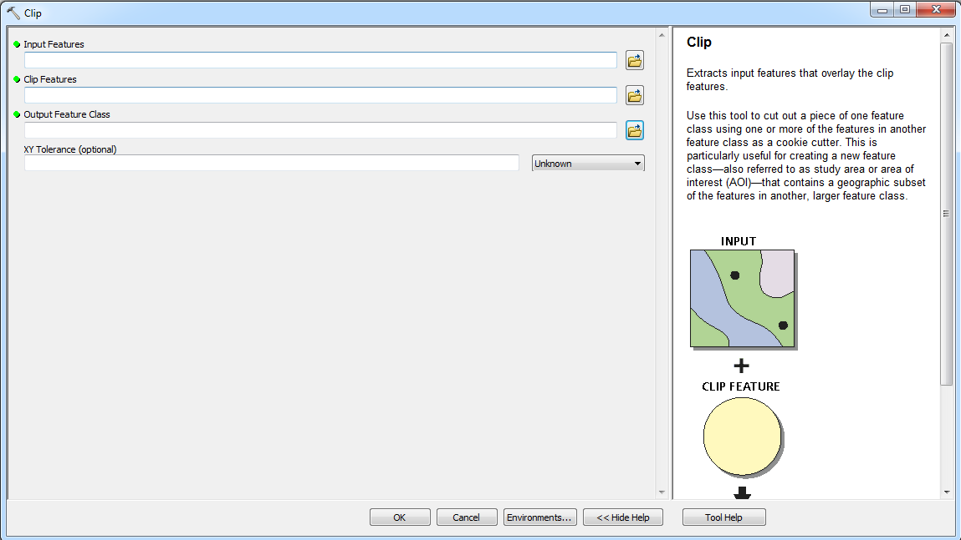
ArcGIS
Main GIS now
The most comprehensive and easiest to use
“Point-and-click” system
Many tools available
Best support
Can make custom tools if something isn’t available
http://desktop.arcgis.com/en/arcmap/10.6/analyze/main/geoprocessing-tools.htm
https://gis.stackexchange.com/
Notes:
While there are many programs available, ArcGIS is currently the best one out there with the most features, best support both official and through forums, and is most used by professionals
ArcGIS is what I call a “point-and-click” program where rather than a programming software where you have to type everything to run a tool/function, you instead run functions by clicking on one from a list and running it through a window
This makes it a really easy system to use and makes finding tools fairly easy
There are many tools available within ArcGIS which we’ll talk about in broad terms
Additionally, ESRI’s support and help for tools is great and gis.stackexchange is quite useful for things that the ESRI help can’t help you with
ESRI also has a number of free tutorials and introductions to ArcGIS features which can be useful
Additionally, if you want to, say combine tools, or make your own, ArcGIS has made it fairly easy to do so using Python and Modelbulider

Slide 13
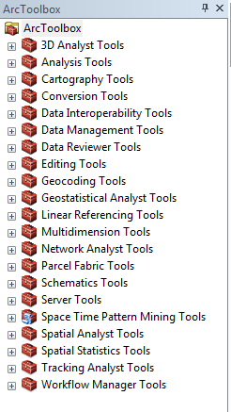
ArcGIS Usage
Making Maps
But it’s also great for:
Spatial data management and editing
Spatial Analysis
Spatial Statistics
Notes:
ArcGIS is great for making maps and other visualizations of spatial data. It’s definitely one of its strengths.
But, it’s also great for doing managing your spatial data files, doing spatial analyses and spatial statistics
The spatial analysis capabilities are really what separate ArcGIS from other programs

Slide 14
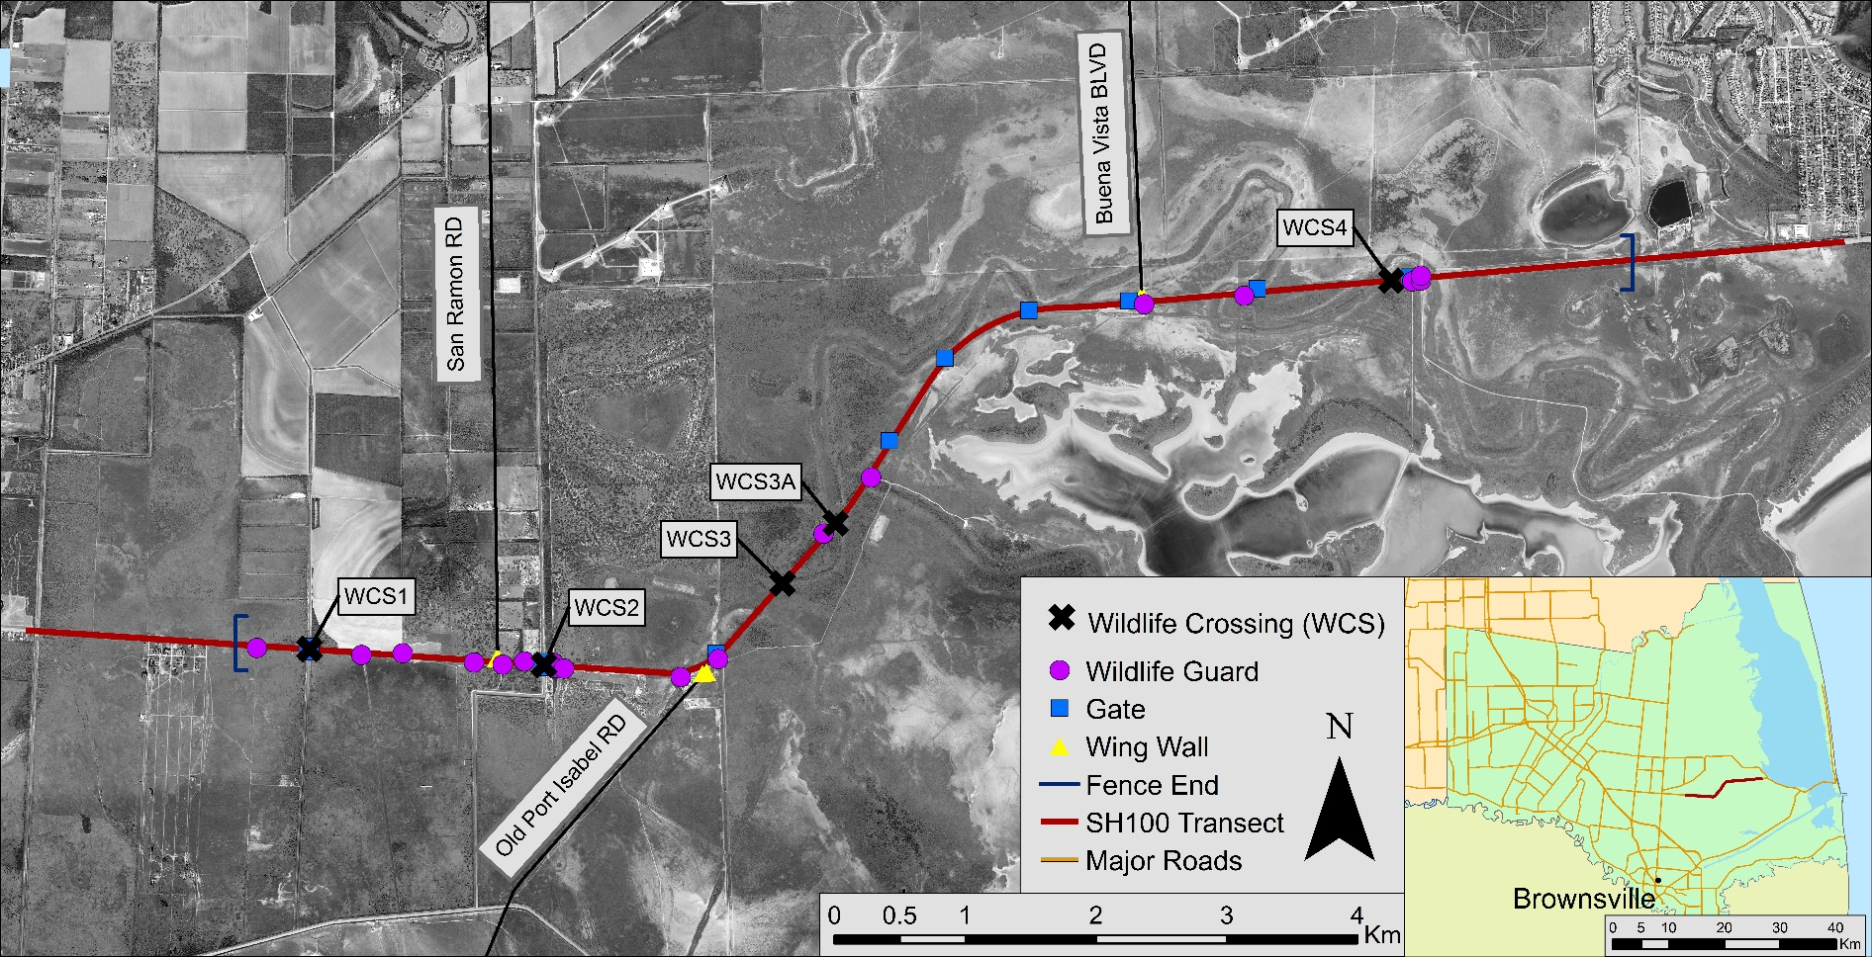
Making maps
https://support.esri.com/en/technical-article/000008629
Notes:
Of course, ArcGIS is great for making maps. You can customize all sorts of things, create as many layers as your graphics card can handle
Can even import custom symbols but thousands are available for download from various sources

Slide 15
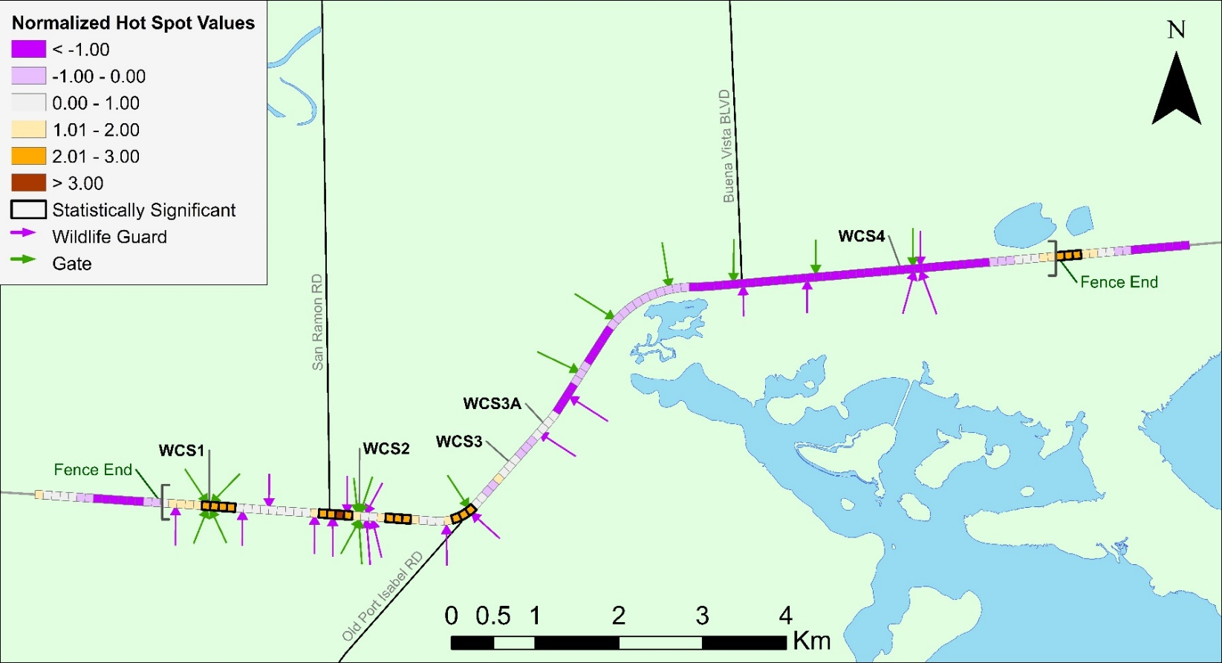
Displaying spatial data
Easiest tool for creating useful visualizations of spatial data
You can see spatial trends in data that you couldn’t see otherwise
Notes:
It’s a powerful tool for displaying spatial data and examining spatial trends which may warrant analysis
So you can on this map which is not preliminary but a representation of a spatial analysis I ran for a conference
Anyway, we’re looking at how concentrated wildlife road mortalities are on SH100
Purple indicates that mortalities are either very spread out or non-existant while oranges represent high concentration of mortalities or there are a lot of mortalities in and near this particular location
If we just had a table of results that said that 18 out of 151 blocks are statistically significant hot spots, it doesn’t tell us much because we don’t know where they are. You can say: “18 isn’t that many so what’s the big deal.” Well, with a map we can see that 15 out 18 are located in a 3km stretch of our 15km transect which is now interesting. Why are they all in that one location? We can start to figure that out now.

Slide 16
Data management
Converting between data types
Handling shapefiles
Editing spatial data
Notes:
We can use ArcGIS to handle shapefiles and other spatial data files
It is great for converting shapefiles into data formats that other programs can read. It can create excel files, google earth, CAD, NetCDF, converts between rasters and shapefiles
Also because we can see the spatial locations of files, editing files becomes fairly simple as well. We can move locations to their correct locations, edit the properties of a point or polygon and this combined with its ability to export to other formats makes it easy to ensure you have good data when you run your analyses

Slide 17
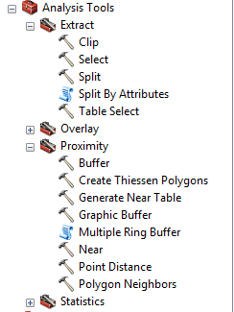
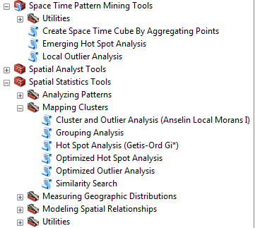
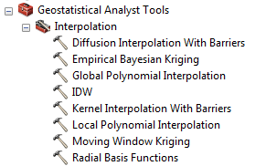
Analysis
Spatial association
Interpolation
Network analysis
Suitability analysis
Statistics
Notes:
Many different analyses we can do in ArcGIS from determining how close things are to each other to identifying the most efficient ways to move through space to understanding spatial clustering using spatial statistics
One of the simplest analysis tools is understanding what’s near something else using buffers or measurement (i.e. near tool)
You can also use it for interpolation to “fill” the space between points.
For example, we can’t sample every location in an area so we sample at certain points. We can then use interpolation to estimate the values between the sampling points
Interpolation shouldn’t be used beyond the edge of the sampling area
There are several different types of interpolation some based on proximity between points some use statistical measures of relatedness
One the most powerful tools in my opinion that ArcGIS has is its spatial analysis and spatial statistics tools
These enable us to easily run statistical analyses on spatial data
The main ones are Moran’s I, Ripley’s K, and G (hot spot analysis). Not only will these tell you if there is statistically significant clustering of high or low values, but they can also tell you where the clustering occurs
This becomes an extremely powerful tool because once we have identified these areas of clustering, we can use regression to figure out why clustering is occurring one location but not another

Slide 18
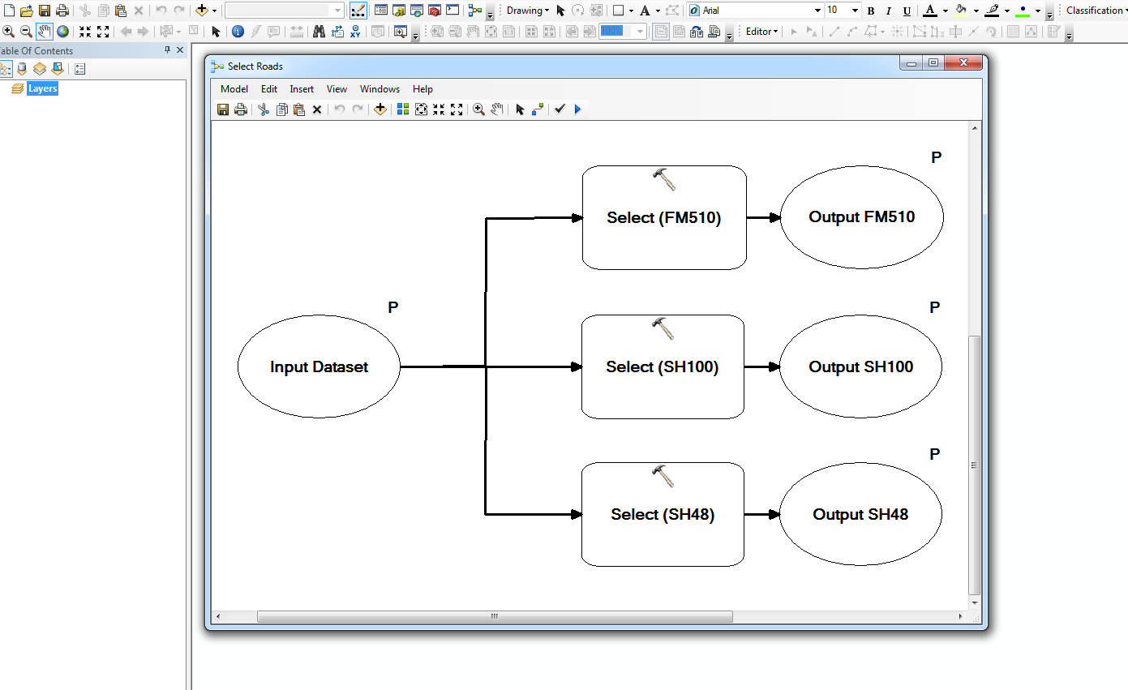
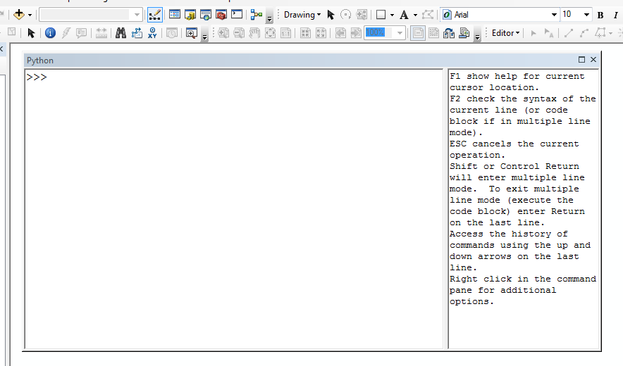
Workflows
Model Builder
Python
Notes:
We know there are a lot of tools and oftentimes we want to combine tools or we use one tool and then the output from that tool in another tool. When we need to do this multiple times or on multiple datasets, it might be easier/faster to create a workflow
In ArcGIS, this is done in a couple ways
1. You can use model builder which allows you to drag and drop tools and files combining them into a single tool. A tool created by model builder runs the same as other tools in ArcGIS
2. You can use Python to create scripts you can run in ArcGIS using the Python window

Slide 19
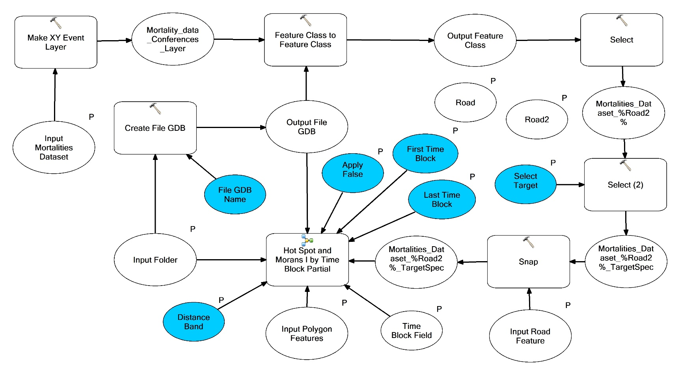
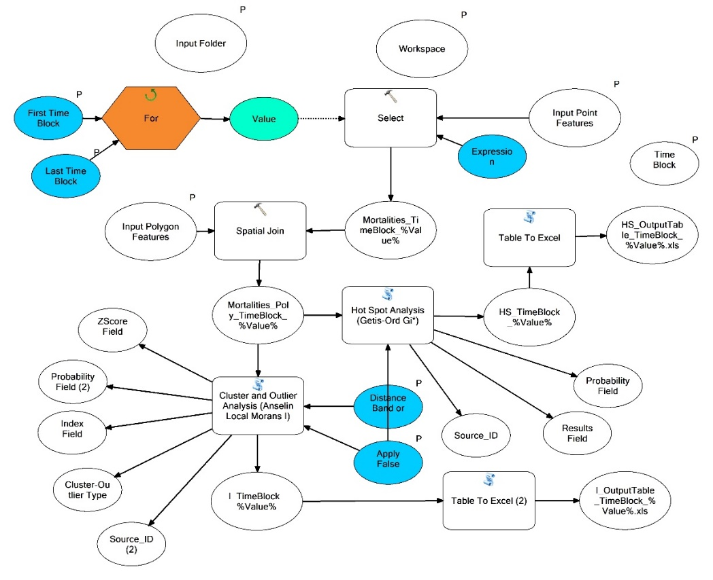
Model Builder function
Allows one to connect several tools together
Can add iterators (For loops) to batch run analyses
Can add models to models
Notes:
With model builder we can do a lot of things. We can add built-in tools and connect them to make more complex tools but also analyses we can run with 1 click instead of 10
As you can see both of these are models. They have a lot of built-in tools but also some other things
You can add iterators which is basically a fancy term for a for loop. This model just has a basic for loop but we can iterate through files, folders, whatever we want using an iterator allowing us to run a tool on many different files at the same time
Unfortunately ArcGIS doesn’t allow you to have multiple iterators in a single model but there is a workaround…
We can add models to models. Because models that we create are tools, they can be added to other models we make. This allows us to have multiple iterators in a single larger model. This example doesn’t have that case but we can do it.

Slide 20
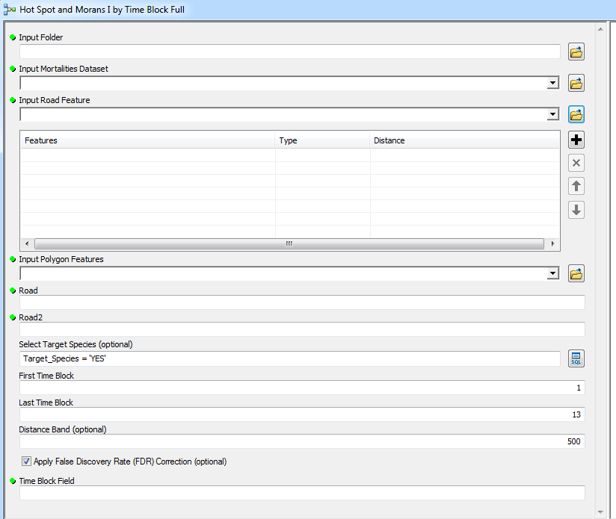
Model Builder interface
Notes:
So once we’ve made the model, we define parameters so we can run it just like any tool
The tool interface for a model makes it easy to run and easy to run on different datasets

Slide 21
Python and GIS
Most GIS softwares are built on Python
ArcGIS Desktop
Built on a 32bit version of Python 2
Being phased out slowly
ArcGIS Pro
Python 3 64bit
Better Python support and integration
GIS of the future
https://pro.arcgis.com/en/pro-app/arcpy/get-started/installing-python-for-arcgis-pro.htm
https://pro.arcgis.com/en/pro-app/arcpy/get-started/what-is-conda.htm

Slide 22
Python 2
Older Python system, initially developed in 2000
Both 32 and 64 bit options
Many programs built on Python 2 that haven’t been ported to Python 3 yet
Including ArcGIS
Python 2 losing support in January 2020
Companies have been working to port programs to Python 3
https://wiki.python.org/moin/Python2orPython3

Slide 23
Python 3
New Python, developed in 2008
Both 32 bit and 64 bit options
Older Python code is being ported to Python 3
Will be the only supported Python version starting in 2020
https://en.wikipedia.org/wiki/Python_(programming_language)

Slide 24
Differences between Python 2 and 3
Print function
Python 2
Print “Hello”
Python 3
Print (“Hello”)
Integer Division
Python 2
5 / 2 = 3
Python 3
5 / 2 = 2.5
Different library options
Some libraries haven’t been ported to Python 3 yet
New libraries only for Python 3

Slide 25
Using Python within ArcGIS
Can use the built in Python scripting tool to create tools for use in ArcGIS
Can’t access libraries that aren’t in ArcGIS already unless its connected to another program
Or make scripts using a Python editor such as Anaconda and import them to ArcGIS
Requires setting up an Anaconda environment for ArcGIS

Slide 26
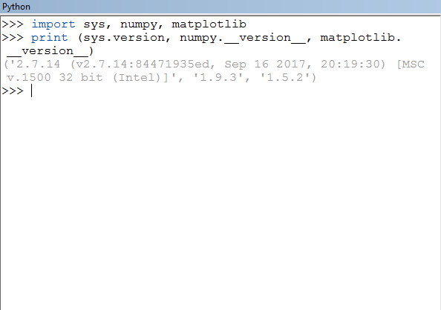
Compatibility between ArcGIS and Anaconda
Need to create an Anaconda environment that is compatible with ArcGIS
32bit Python 2 environment
Needs same versions of Python, numpy and matplotlib as ArcGIS
We’ll cover this more in the lab portion

Slide 27
Issues with ArcGIS in Anaconda
ArcGIS built in Windows while Python built in Unix
ArcGIS Desktop is a 32bit program
Need a 32bit version of Anaconda
Many Python libraries are 64bit only
Example: Fiona
Installing a 64bit only library will convert your Anaconda Environment to 64 bit making it incompatible with ArcGIS
https://www.anaconda.com/distribution/#windows
Notes:
Windows was 32bit until Windows Vista
Unix systems switched to 64 bit much earlier than windows

Slide 28
Issues with ArcGIS in Anaconda
ArcGIS compatible versions of libraries sometimes lost in Anaconda
Anaconda will update libraries if you install a package that requires a newer version than ArcGIS does
Anaconda ensures compatibility between libraries and Python within the Anaconda environment
Arcpy will still work but may have issues

Slide 29
Using ArcGIS tools outside of ArcGIS
Still need ArcGIS installed on the computer you’re working on
Still need to create a path “connecting” ArcGIS to Anacaonda
Some ArcGIS tools won’t run outside of ArcGIS
Require certain conditions that can only be true in ArcGIS
A result of bad programming

Slide 30
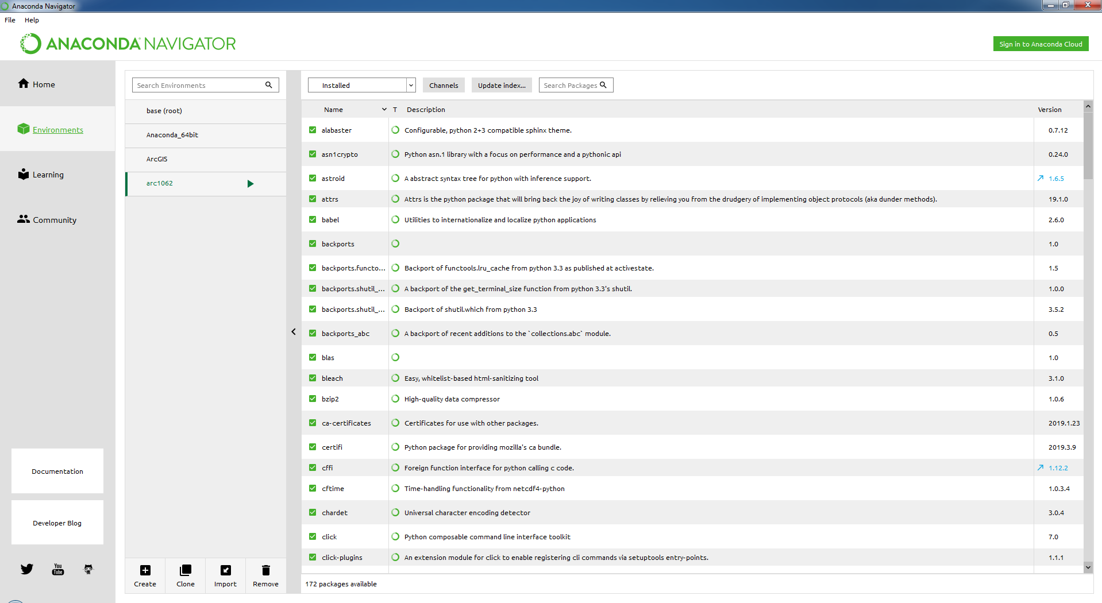
Setting up a Python 2 environment

Slide 31
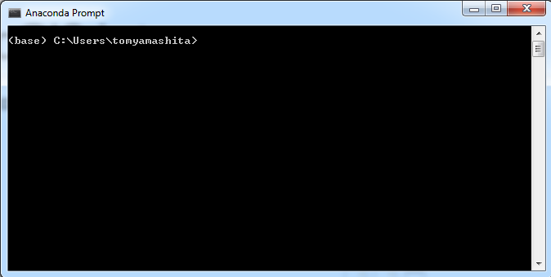
Command line set up

Slide 32
ArcGIS intro

Slide 33
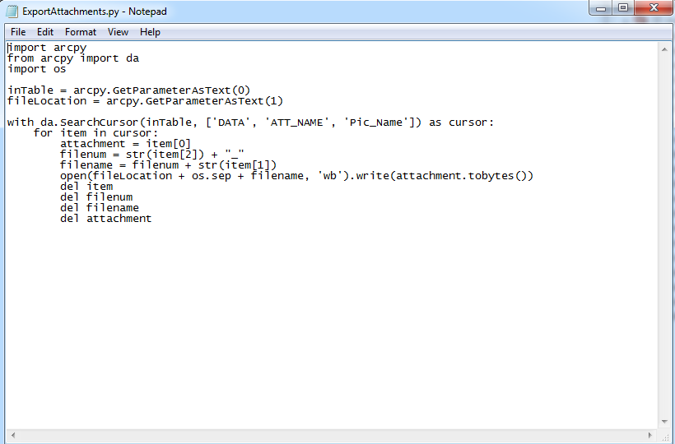
Python scripts in ArcGIS

Slide 34

Questions?
Photo credit: Kline Lab at UTRGV
Notes:
…

Slide 35

Acknowledgements
Dr. Cheryl Harrison for inviting me to speak
All the websites I stole icons from
ESRI for existing and making ArcGIS
Python and R development teams
Contact:
Thomas.yamashita01@utrgv.edu
Photo credit: Kline Lab at UTRGV

